Slide 1
Genome Editing in Germ cells
Hyesook Cho
Franklin University
NURS-425
Professor Rachel Choudhury, MSN, RN, CNE
March 16, 2022

Slide 2
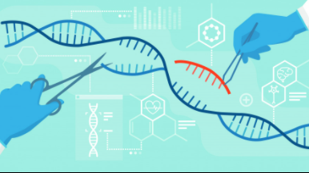

Gene editing is cutting or inserting genes. Using this technology, you can not only cut but also add genes where you want them.
Notes:
Gene editing is cutting or inserting genes. Using this technology, you can not only cut but also add genes where you want them. If you insert a new DNA sequence you want to add together with CRISPR Cas9, the cell will absorb the added DNA sequence in the process of repairing the cut part. It will be possible to 'edit' by literally cutting a gene and pasting another gene.
But it's not that you're just changing the gene you want to change, it's that you're affecting too much of the DNA around the gene you're trying to edit that you could accidentally affect other genes and cause problems.

Slide 3
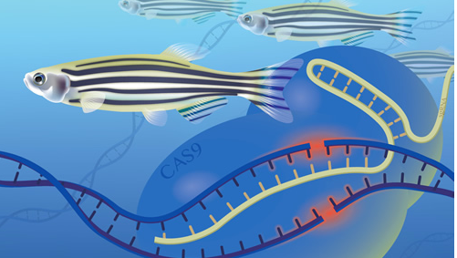
Policy NIH(National Human Genome Research Institute) Scientists shouldn't edit the genome of germline cells. 1. Gene editing is not perfect. 2. The compilation of the gonads will be passed down from generation to generation.
Notes:
The policy of humen genome is. According to the National Institute of Human Genome (NIH), genome editing technology has advanced, but there is a technical barrier that gene editing is not perfect.
And there are ethical concerns:1. Is it okay to use gene therapy when I cannot get a treatment authorization from the embryo? Is it enough to get your parents' permission?
2. Should scientists be able to edit germ cells? The compilation of the gonads will be passed down from generation to generation.
The conclusion is that scientists should not edit the genome of germ cells.

Slide 4
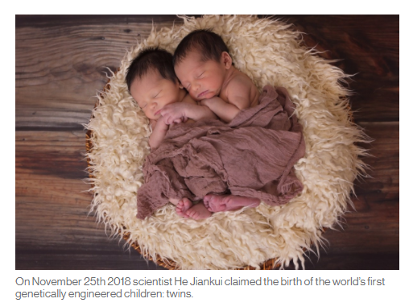
Issue On november 25th 2018 scientist he jiankui claimed the birth of the world’s first genetically engineered children: twins.
YouTube, persuasion and genetically engineered children | The MIT Press
Notes:
In 2018, Chinese scientist He Jiankui was sentenced to three years in prison for using gene-editing technology to create twin fetuses, despite a ban on genetic testing using human embryos. Becaus of he modified the gene to not express the CCR5 gene, which encodes a protein that allows HIV to enter cells. He argued that the father of the fetus was HIV-infected, and he wanted to eliminate the possibility of the baby being infected with HIV. This incident violated the scientific consensus to limit human genome editing technology other than somatic cell research.

Slide 5
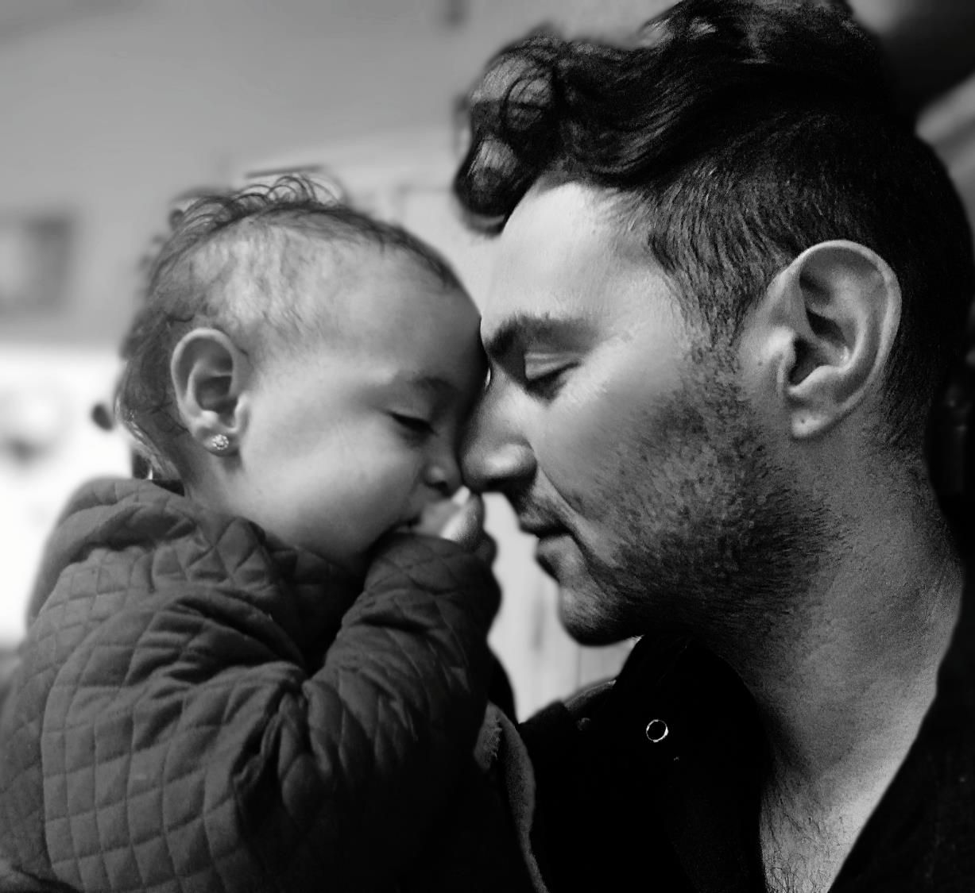
Human genome editing: a framework for governance
Each country should prepare guidelines for conducting research under ethical and appropriate supervision and creating conditions for ensuring social justice. in 2021, WHO
Notes:
After this incident, the WHO Committee on the Development of International Standards for Human Genome Editing Policy and Oversight was formed in 2019. However, in 2021, WHO announced Human genome editing: a framework for governance in 2021. The content emphasized that each country should prepare guidelines for conducting research under ethical and appropriate supervision and creating conditions for ensuring social justice. She also said that “cultural change” among researchers is necessary to establish a system for detecting and reporting unethical experiments. Dr Sumiya Swaminathan, WHO Chief Scientist, said: “The new report from WHO must understand the human genome, minimize the risks of human genome editing, and leverage how science is driving better health for humanity everywhere.”

Slide 6
The ethical demand for reproductive editing
1. Evaluate whether the benefits outweigh the risks.
2. Whether this type of research and clinical process is ethical, and whether it violates social safety.
3. Potential risks for children who cannot agree with this process, commercialization of children, social inequality, and criminal possibility problems.

Slide 7
Reference Nicholas W. (2015). Scientists Seek Ban on Method of Editing the Human Genome. The New York Times Company. Scientists Seek Ban on Method of Editing the Human Genome - The New York Times (nytimes.com) NIH. (2015), What is genome editing. What is genome editing? Singh A. N. (2021). Ethical Controversies and Challenges in Human Genome Editing. International Medical Journal 28(2). Pp 134-137. https://links.franklin.edu/login?url=https://search.ebscohost.com/login.aspx?direct=true db=rzh&AN=149537843&site=ehost-live WHO. (2021). Human genome editing: a framework for governance Human genome editing: a framework for governance (who.int)

Slide 8
Thank You!

